Slide 1

Financing joint measures across sectors for resilience at transboundary basin scale: towards more cooperative and impactful climate action
17 November 2022
Mahamat ASSOUYOUTI, Senior Climate Change Specialist
Adaptation Fund

Slide 2
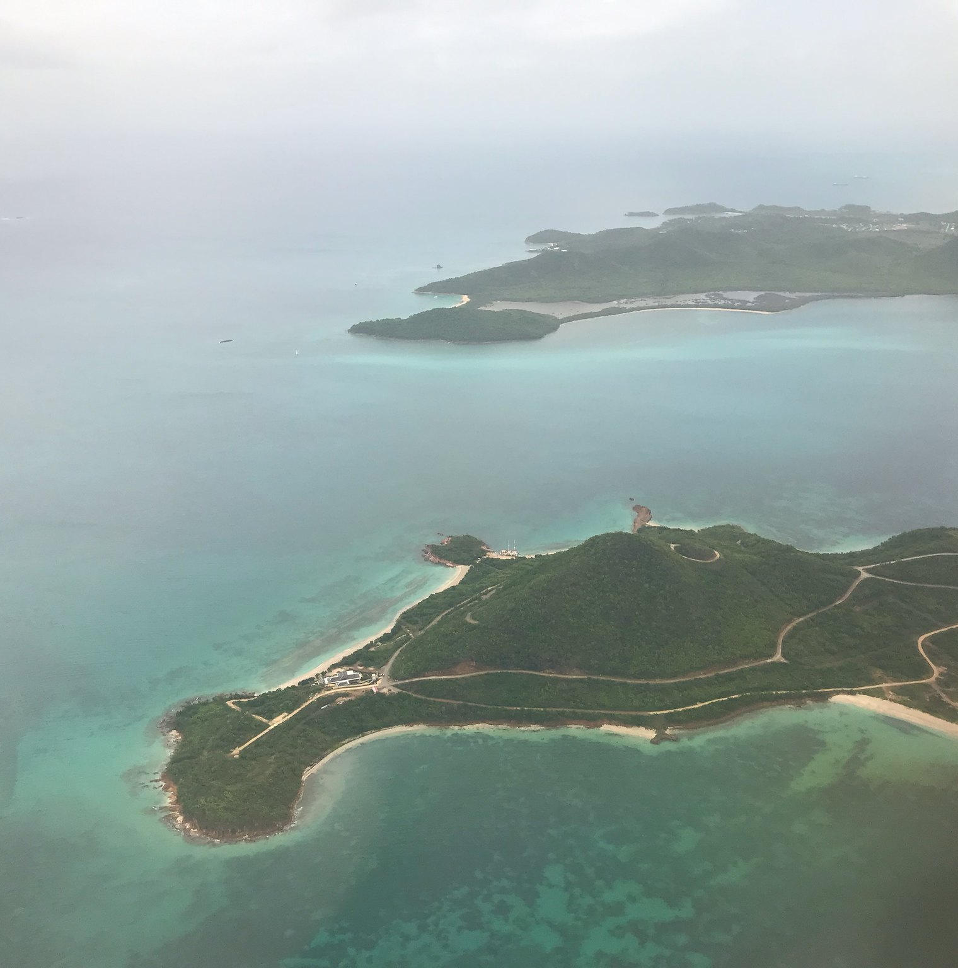



Adaptation Fund
Pioneered Direct Access – finances concrete adaptation projects/programs
A total of 56 IE (34 NIEs, 14 MIEs, 8 RIEs)
US$1billion portfolio in grant funding including US$205million for transboundary projects/34 countries

Slide 3
AF REGIONAL WINDOW – ACCESS MODALITY
Pilot programme introduced in 2015 with at cap of $30 million Up (AFB.25/28)
to $14 million and $100k PPG for regional project (2+ countries)
Implemented by MIE or RIE and endorsement by each DA of participating countries
Concrete adaptation actions in multiple sectors including including Transboundary Water Management, Enabling Environment, water security, Nature-Based Solutions, EBA, etc.
Total of US$151M under the regional window, or 20% total portfolio
Funding on the basis of the full cost of adaptation (No co-financing required, addressing adaptation needs and co-benefits if any, no BAU)
Environmental, socio-economic benefits especially for the most vulnerable and gender considerations

Slide 4
LEARNING FROM ADAPTATION FUND TRANSBOUNDARY PORTFOLIO
Increased cost-effectiveness and enhanced coordination
  Country-by-country approach to adaptation could lead to duplication of efforts or even negative and costly outcomes elsewhere
  A centralized form of coordination at the regional, supranational scale has proved to be key in delivering cost effective management, including collective procurement with higher purchase power
  A transboundary approach to adaptation can achieve cost savings through economies of scale
Cooperation through learning and knowledge sharing across scales
  Transboundary projects offer many opportunities for learning and knowledge transfer, about what works, where and why, across local, national and supranational scales
  Extreme shocks such as the COVID-19 pandemic in all regions have provided learning opportunities in adaptive management across all transboundary projects (virtual workshops, online knowledge sharing across regions)
  Inclusion of comprehensive risk assessment and adaptive management in implementation arrangements from the outset
  Up-to-date data and information from national-level agencies, regional institutions and international organizations lead to a strong proposal and builds trust with national-level agencies

Slide 5

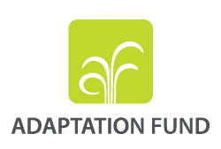



Thank You
Mahamat Assouyouti
massouyouti@adaptation-fund.org
www.adaptation-fund.org

